Slide 1

More Performance Data
CSC4010
David Cutting – d.cutting@qub.ac.uk

Slide 2
Scenario
Took a Monte Carlo Pi simulation
Ran in different number of processor (cores) environments
Each script ran the sequential version and then parallel version
  Note: not compiled each time, why?
Captured wall time and CPU time

Slide 3
5,000,000 points
2 to 128 processors
10 executions of each P count

Slide 4
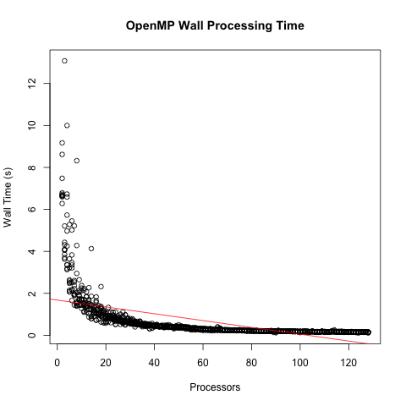

Slide 5
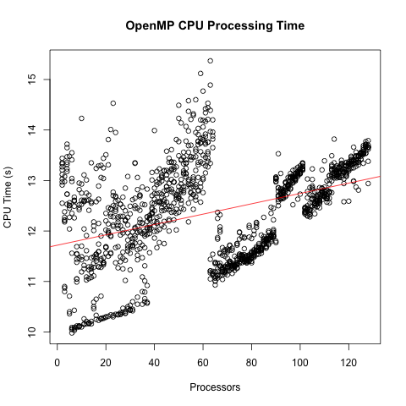

Slide 6
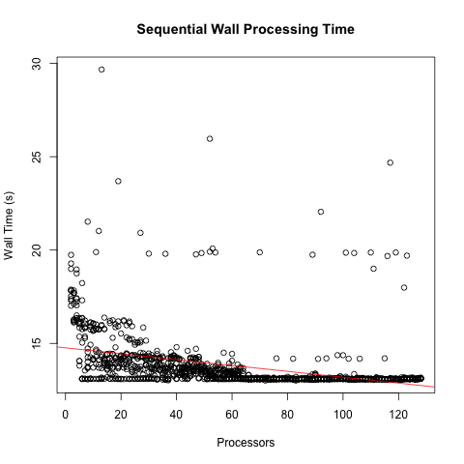

Slide 7


Slide 8
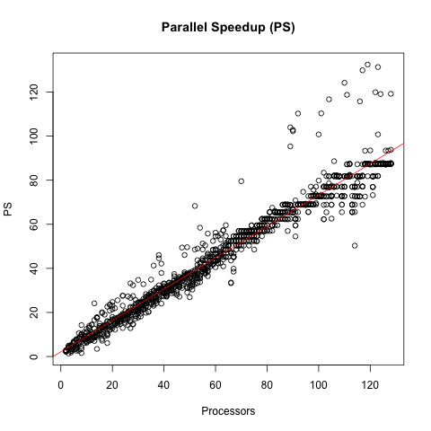

Slide 9
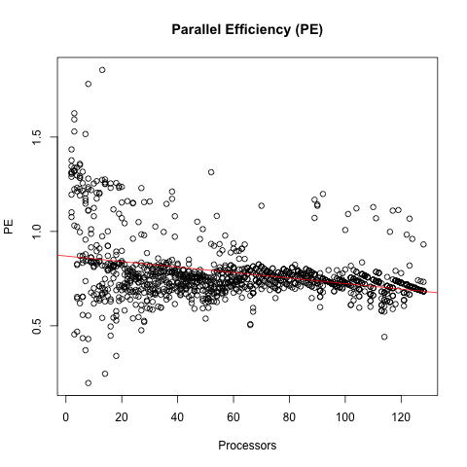

Slide 10
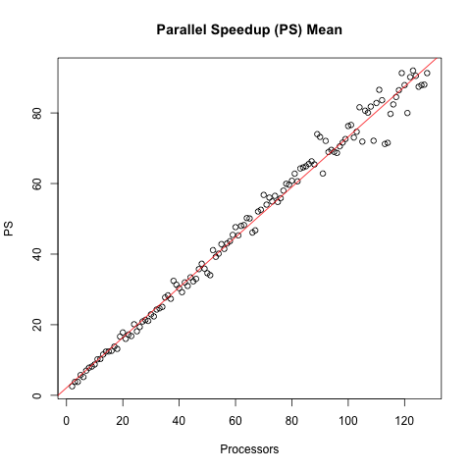

Slide 11
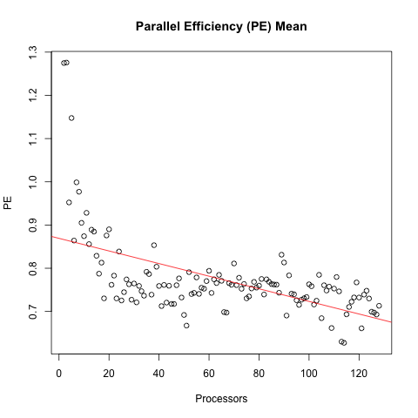

Slide 12
5,000,000,000 points
2 to 128 processors
10 executions of each P count

Slide 13
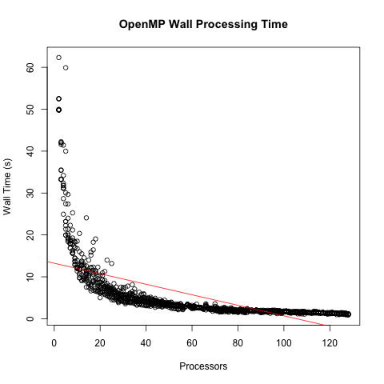

Slide 14
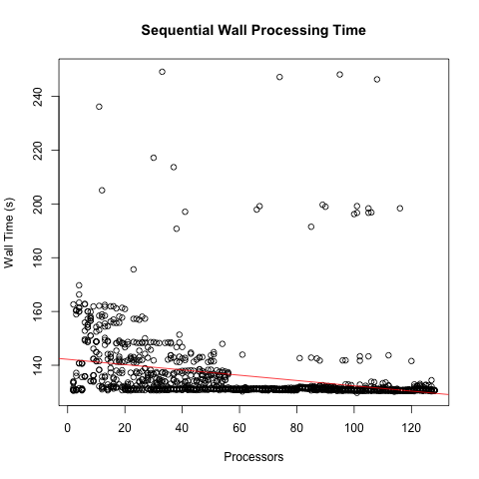

Slide 15
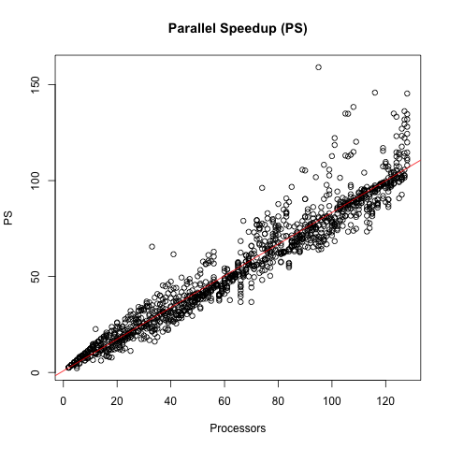

Slide 16
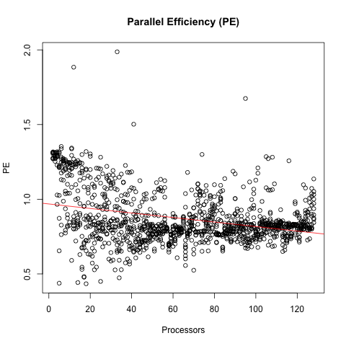

Slide 17
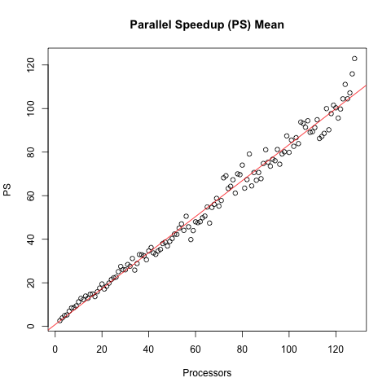

Slide 18
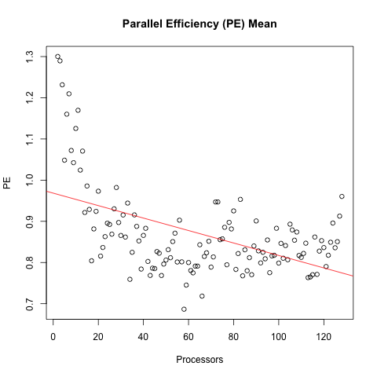

Slide 19
5,000,000,000 points
2 to 32 processors
100 executions of each P count

Slide 20
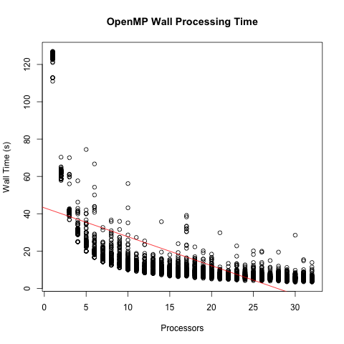

Slide 21
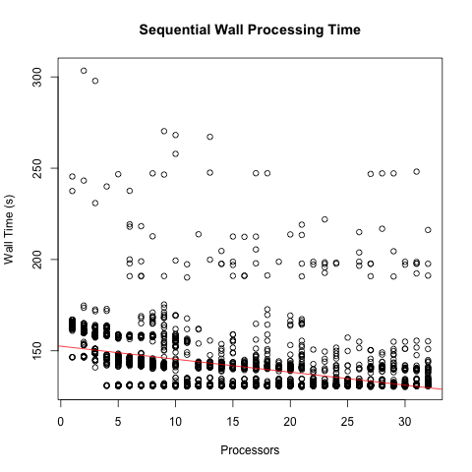

Slide 22
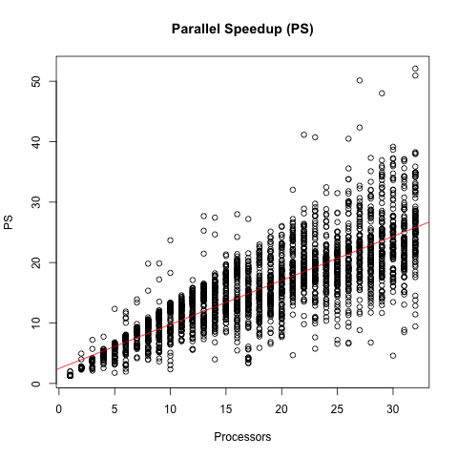

Slide 23
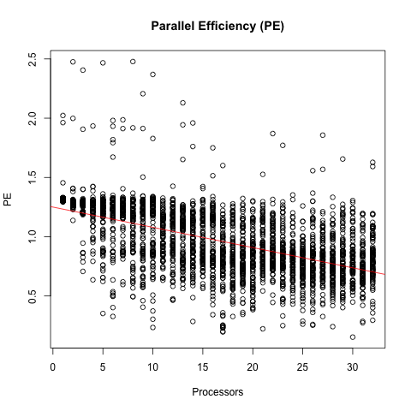

Slide 24
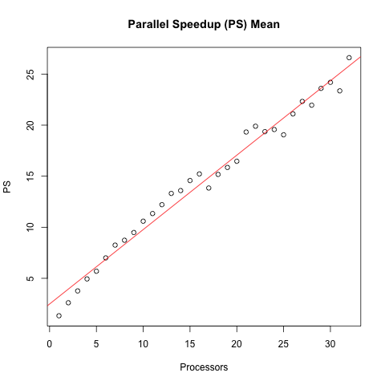

Slide 25
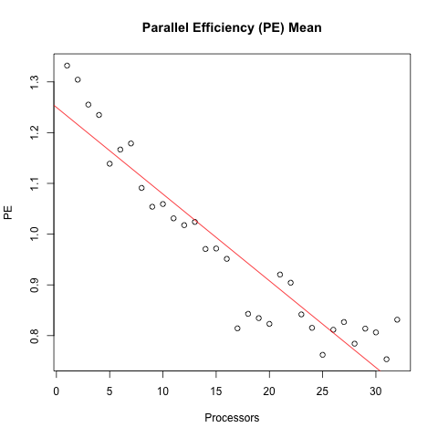

Slide 26

?
?
?
?
?
?
?
?
?
?
?

